Slide 1
Database System
CL 203
Lab 01
Simple SQL schema and related queries

Slide 2
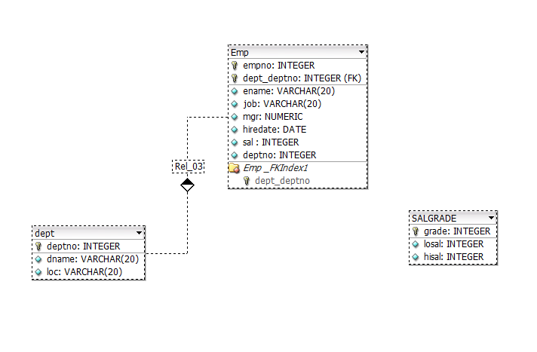
Simple Schema

Slide 3
Schema
EMP (empno, ename, job, mgr, hiredate, sal, deptno)
DEPT (deptno, dname, loc)
SALGRADE (grade, losal, hisal)

Slide 4
Step 1
Retrieve all rows & columns from the emp table.
SELECT * FROM emp;
// ‘*’ denote all attributes. See other tables.

Slide 5
Step 2
The columns to be selected from a table are specified after the keyword SELECT.
SELECT empno, ename, sal FROM emp;

Slide 6
Step 3
The SELECT clause may also contain arithmetic expression, e.g.
SELECT ename, deptno, sal * 2 FROM emp;

Slide 7
Step 4
Keyword DISTINCT forces elimination of duplicates from the query result.
SELECT DISTINCT job FROM emp;

Slide 8
Step 5
To sort the result ORDER BY clause is used. It takes one or more attributes listed in the SELECT clause. Asc specifies ascending order (default order) and desc specifies descending order.
SELECT ename, deptno, hiredate FROM emp
ORDER BY deptno asc;

Slide 9
Step 6
To select tuples that satisfy certain condition, WHERE clause is used. WHERE clause condition contains logical expressions connected by and, or and not to form complex conditions. Conditions may also include pattern matching and subqueries.
List name, job title and the salary of those employees whose manager has the number 7698 or 7566 and who earn more than 1500.
SELECT ename, job, sal FROM emp
WHERE (mgr = 7698 or mgr = 7566) and sal > 1500

Slide 10
Step 7
List name, job and hiredate of employees working in department number 20 or 30.
SELECT ename, job, hiredate FROM emp
WHERE deptno IN (20,30);
BONUS QUESTION: ( 1 mark )
Can you write it in another way, considering the step 6 example?

Slide 11
Step 8
List the emp_no and name of employee who has no manager.
SELECT empno, ename FROM emp
WHERE mgr IS NULL;

Slide 12
Step 9
List emp_no, name and job of employees whose salary is between 1500 – 2500
SELECT empno, ename, job FROM emp
WHERE sal BETWEEN 1500 AND 2500;
BONUS QUESTION: ( 1 mark )
Can you write it in another way?

Slide 13
Step 10
In string comparison surround the string by apostrophes. List employees name and salary of those employees working in department located in DALLAS.
SELECT ename, sal
FROM emp e, dept d
WHERE e.deptno = d.deptno AND d.loc = ‘DALLAS’;

Slide 14
Step 11
For pattern matching like operator is used. Two special characters are used: the percent sign (%) and under score (_). Percent sign means that any string is allowed there, while under score stands for exactly one character. Find name and job of employees whose name contain substring ‘LL’.
SELECT ename FROM emp
WHERE ename like ‘%LL%’;

Slide 15
Step 12
Aggregate functions return a single value for a set of column values. Count the number of employees.
SELECT count(*) as Total_Employees FROM emp;

Slide 16
Step 13
Following query displays employees names, dept number and location. Look how join works.
SELECT e.ename, e.deptno, d.deptno, d.loc
FROM emp e, dept d
WHERE e.deptno = d.deptno;

Slide 17
Exercises:
Display the name, job, and salary for all employees whose job is Clerk or Analyst and their salary are not equal to Rs.1000, Rs.3000, or Rs.5000. Display in descending order of salary. (4 rows)
Calculate the average salary of all the employees. (2073.21429)
List all the employees names, their department numbers and hire date with ascending order of dept numbers and descending order of hire date within a particular dept. (multiple columns in ORDER BY clause).
Find emp_no, name, salary and hire date of the employees who were hired in the first half year of 1981. Sort the output in ascending order of hiredate.
List name of employees along with name of their departments. Sort by department name.
How many different job titles are stored in the relation emp? (5)
List the minimum and maximum salary in relation emp. (800, 5000)
Sum all the salaries of employees working in the SALES department. (9400)
Compute the difference between the minimum and maximum salary. (4200)
List all employees whose name contains A in the third position. (3 names)
How many employees earn more than Rs. 2000. (6 emps)
Find total number of salesman and the sum of their salaries. (14, 29025)
List name of all employees along with the NAMES of their managers. (13 rows)

Slide 18
References:
Operators and functions available in Oracle:
For numbers: abs, cos, sin, exp, log, power, mod, sqrt, +, -, *, /,……..
For strings: concat( str1, str2 ), lower(column/expr), upper(column/expr), replace(str, search_str, replacement_str), concat(column1/expr1, column2/expr2), substr(str, m, n), length(column/expr), initcap(column/expr), …..
For dates: add_months(date,n), month_between(date1, date2), next_day(date,’char’), last_day(date), ……
Comparison operators:
=, != or <>, <, >, <=, =>
Set Conditions: WHERE <column> [NOT] IN (<list of values>)
Null Value: WHERE <column> IS [NOT] NULL
Domain Conditions: WHERE <column> [NOT] BETWEEN <lower bound> AND <upper bound>
Aggregate Functions:
count: used for counting rows
max: maximum value for a column
min: minimum value for a column
sum: computes the sum of values (only applicable to the data type number)
avg: computes average value for a column.
Note: avg, min and max ignore tuples that have a null value for the specified attribute, but count considers null values.

